Slide 1
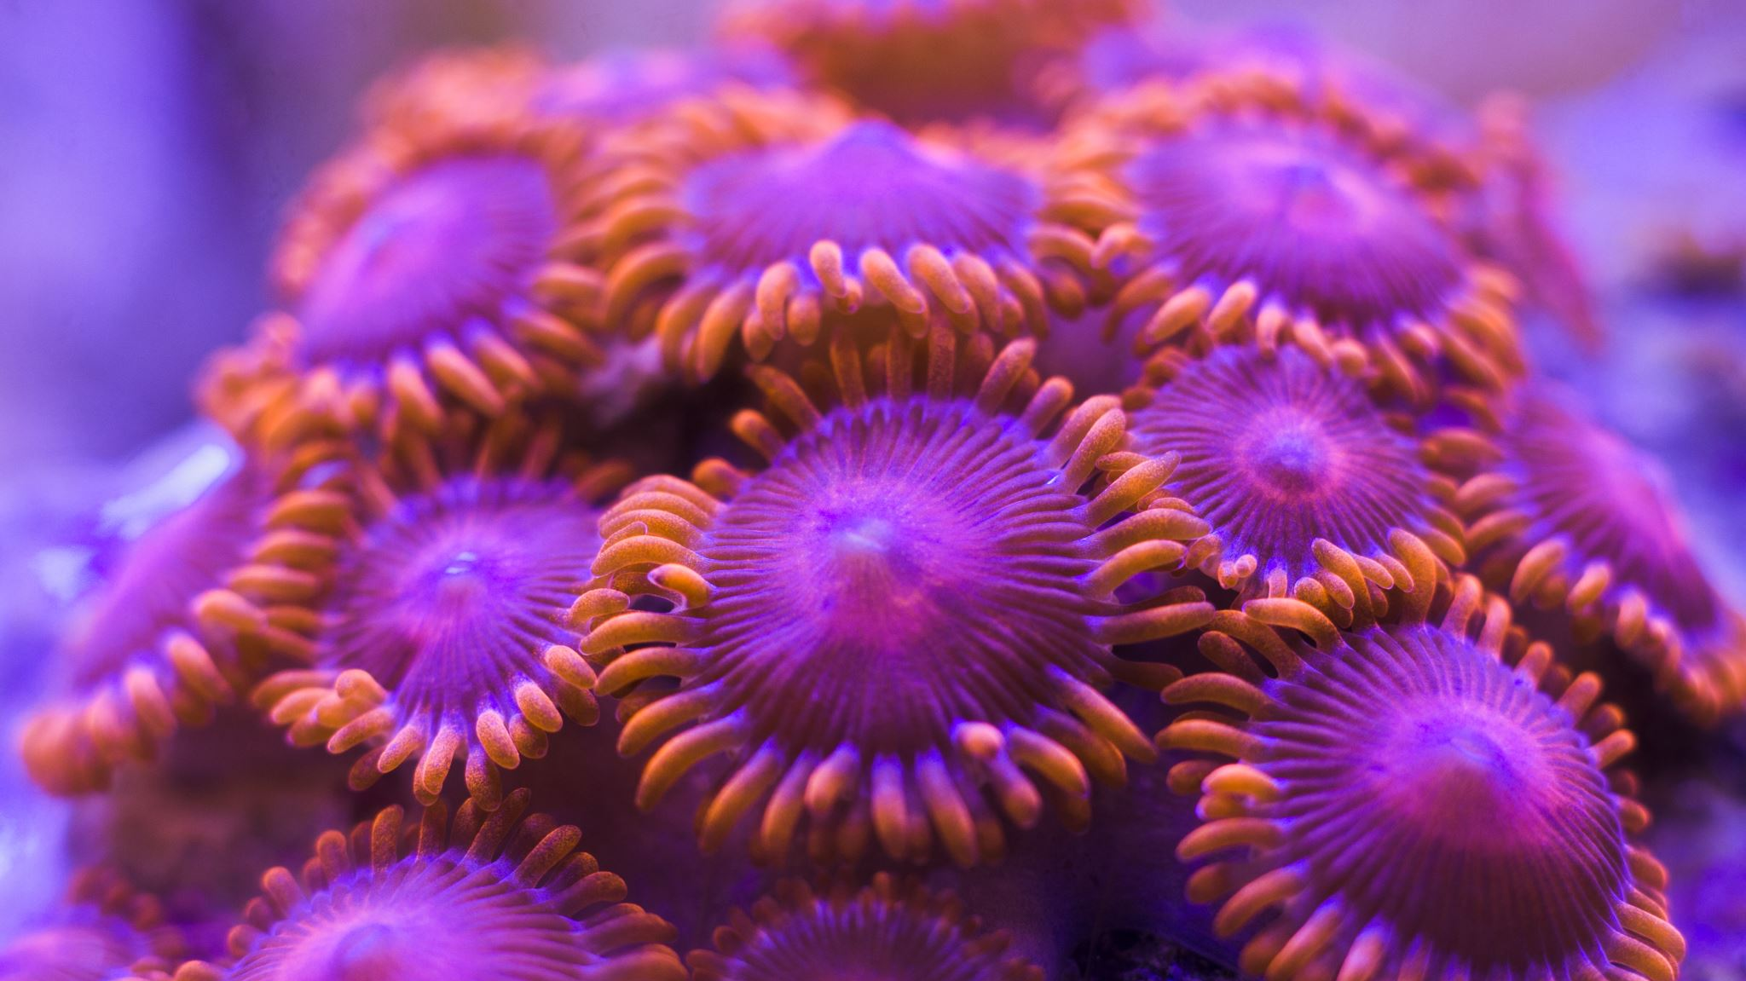
Marine Animal Species Recognition
An AI model development to aid in marine research and explore the life in the seas below
M A R I N E M I N D
Team Members
Sriram B. Swami
Abishek Arun
Aalok Hasabnis
22BCE5103
22BCE1063
22BCE1083

Slide 2


| Problem Statement
Marine biology is a crucial field in the scientific research of flora, fauna and its evolution. As of 2022, about 242,000 marine species living in the world's oceans have been identified. Marine biota continue to be discovered about 2,332 new species per year.
How can we develop an AI driven machine learning model to identify and classify different marine species from underwater images?
The objective is to create an automated system that can accurately recognize various species of marine life from images captured in underwater environments, assisting researchers and conservationists in monitoring and studying marine biodiversity.

Slide 3

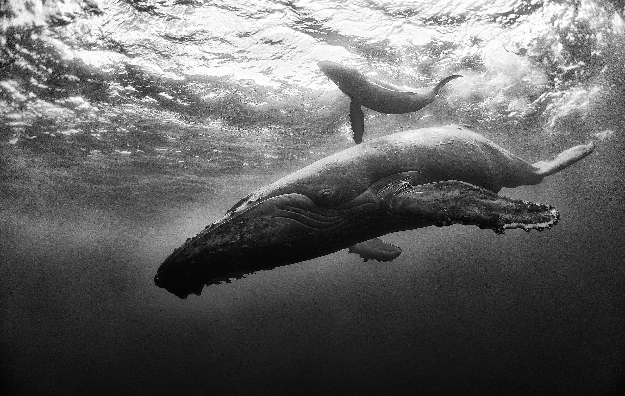
| Novelty of this project
The discovery rate of these marine biota is possibly being held back by the limitation of needing manual interference under the sea to identify species and their characteristics.
Identifying underwater species from images is a challenging task due to the often low-quality and diverse nature of underwater photography. Developing a model for this purpose can advance marine research and conservation efforts by providing automated tools for species identification and monitoring.

Slide 4

| Architecture & Scope of the projecT
Data Collection:
Dataset Source: Initially inspired by the Fish4Knowledge Dataset, which contains annotated images of fish and other marine species captured in various underwater environments, we use a more analytic dataset from Kaggle titled ‘Sea Animals Image Dataset’ with more images and 23 classes.
Attempted to supplement with other underwater datasets if needed, such as the Oceanic Species Dataset for better depth.
Data Preparation:
Preprocess images to handle varying light conditions, angles, and water clarity.
Augmentation layers for handling rotation, contrast, zoom, flipping, etc.
Annotate and label images with species information if not already provided.

Slide 5
| Architecture & Scope of the projecT
Model Development:
Feature Extraction: Using CNN architecture ResNet50V2 to extract features from underwater images.
Species Classification: Design of a classification model to predict the species based on extracted features.
Evaluation:
Measure model performance using metrics like accuracy, precision, recall, and F1-score.
Validate the model using a test set and adjust based on performance metrics.
Deployment:
Potentially develop an application where users can upload underwater images for species identification.
Consider integrating with a database of marine species for additional information and conservation status.
Automated | AI driven | Scalable | Fine-tuning | Large Datasets

Slide 6
| Design Methodology
Preprocessing
Image denoising using Adaptive Median Filter (AMF)
Remove salt-and-pepper noise
Sharpen, preserve edges and fine details of the image
Resizing and Normalization
Data augmentation: account for disorientation
2. Feature Extraction
Utilize Convolutional Neural Network (CNN) architectures
ResNet50V2 as base model
Incorporating Involutional Neural Network (INN) layers
Location-specific, channel-agnostic kernels
Effective for location-specific classification
Species Classification
Design a classification model based on extracted features
Fine-tune the model on the Sea Animals Image Dataset and supplementary marine datasets
Model Optimization
Implement residual connections (inspired by ResNet architecture)
Allows for deeper architectures without vanishing gradient problems
Experiment with different hyperparameters and model configurations

